Slide 1

MATHS

Slide 2
TOPICS
ALGEBRA
LINEAR ALGEBRA
EQUATION OF LINE
MATRIX
SCALE VACTOR
OPERATIONS ON VECTOR
TRANSPOSE
COFFICIENT
WEIGHT ,BIAS
MATRIX ADDTION,SUB, MUL
MATRIX DOT PRODUCT

Slide 3
https://www.mathsisfun.com/algebra/introduction.html
https://www.mathsisfun.com/algebra/introduction-multiply.html
https://www.mathsisfun.com/algebra/equation-formula.html
https://www.mathsisfun.com/algebra/inequality.html
https://www.mathsisfun.com/algebra/inequality-solving.html
https://www.mathsisfun.com/algebra/definitions.html
https://www.mathsisfun.com/algebra/logarithms.html
https://www.mathsisfun.com/algebra/polynomials.html

Slide 4
https://www.mathsisfun.com/equation_of_line.html ***
https://www.mathsisfun.com/data/straight_line_graph.html
https://www.mathsisfun.com/data/cartesian-coordinates.html
Intercept (bias)
Cofficient (weight)
https://www.mathsisfun.com/algebra/quadratic-equation.html
https://www.mathsisfun.com/quadratic-equation-solver.html

Slide 5
Vector
https://www.mathsisfun.com/algebra/vectors.html
https://www.mathsisfun.com/algebra/vectors-dot-product.html
https://www.mathsisfun.com/algebra/vector-unit.html
https://www.mathsisfun.com/algebra/vectors-cross-product.html

Slide 6
Calculus
https://www.mathsisfun.com/calculus/index.html
https://www.mathsisfun.com/calculus/introduction.html
https://www.mathsisfun.com/calculus/derivatives-introduction.html *******
https://www.mathsisfun.com/calculus/derivative-plotter.html
https://www.mathsisfun.com/calculus/integration-introduction.html https://www.mathsisfun.com/calculus/differential-equations.html https://www.mathsisfun.com/algebra/functions-maxima-minima.html
https://www.mathsisfun.com/calculus/continuity.html

Slide 7
https://www.mathsisfun.com/gradient.html
https://www.mathsisfun.com/y_intercept.html

Slide 8
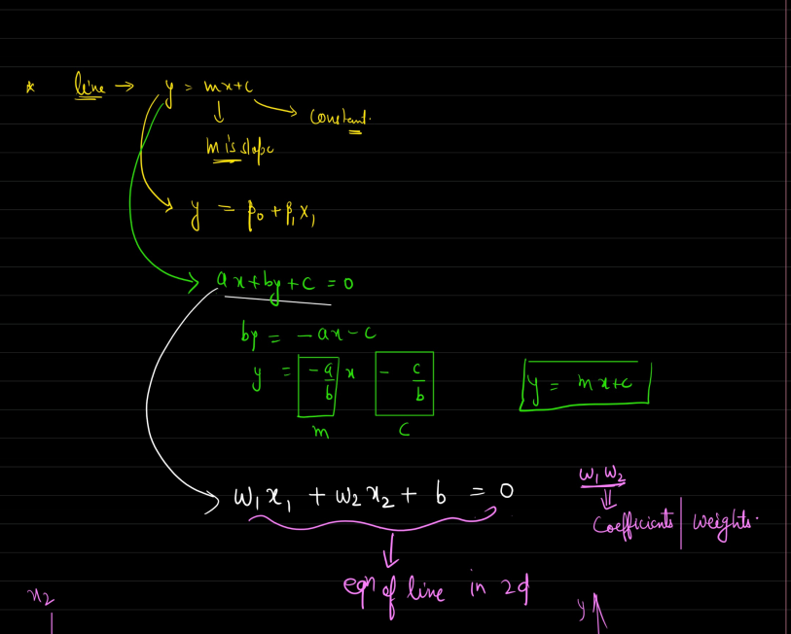
Equations of line
y-=mx+c
slope(gradient), coefficient
intercept
https://www.freecodecamp.org/news/how-machine-learning-leverages-linear-algebra-to-optimize-model-trainingwhy-you-should-learn-the-fundamentals-of-linear-algebra/ usecase ml

Slide 9
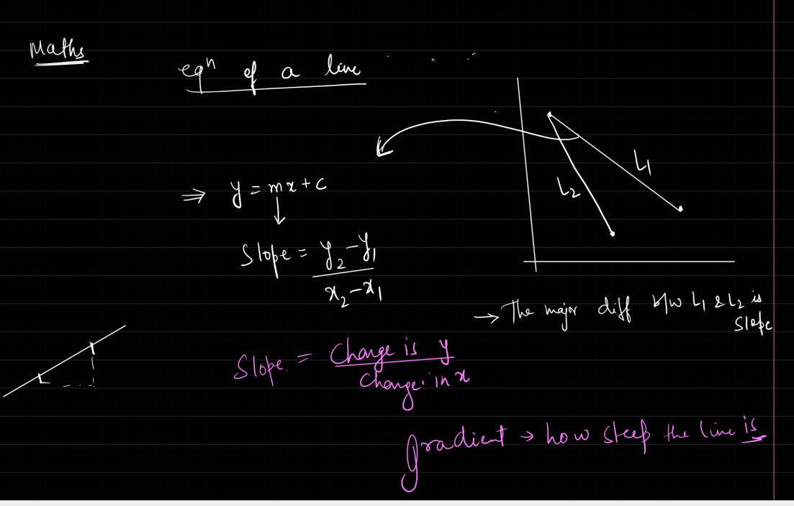
https://www.analyticsvidhya.com/blog/2022/06/linear-algebra-for-data-science-with-python/

Slide 10
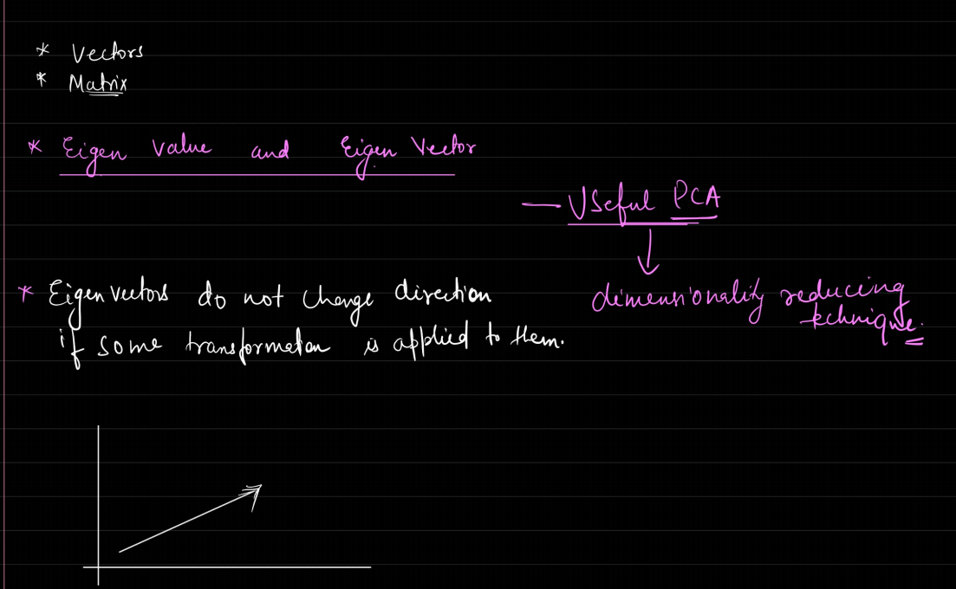
https://jonathan-hui.medium.com/machine-learning-linear-algebra-eigenvalue-and-eigenvector-f8d0493564c9
https://www.geeksforgeeks.org/applications-of-eigenvalues-and-eigenvectors/
https://vitalflux.com/why-when-use-eigenvalue-eigenvector/

Slide 11
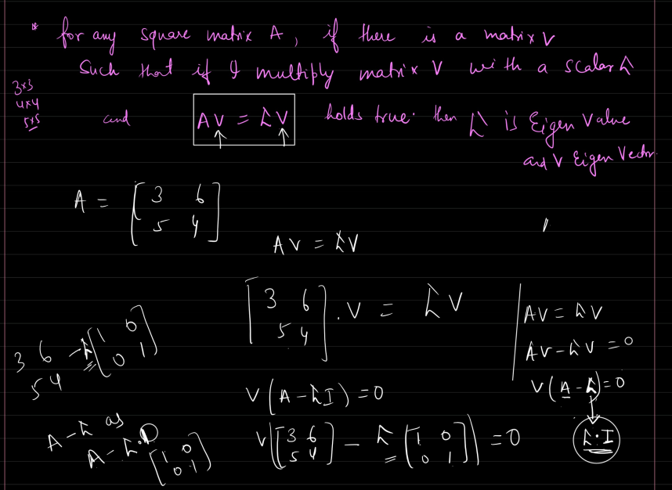

Slide 12
K-means clustering?
: What are the factors needed to decide the value of K in K-means clustering?
An
. Elbow Method:
Silhouette Score
Cross-Validation
Domain Knowledge
. Practical Considerations
What is Euclidean Distance?
manhatten Distance
concept of the Elbow Method.
Q: Elaborate on the difference between algorithms for measuring the distance between two clusters
. Single Linkage (Nearest Neighbor):,Complete Linkage (Farthest Neighbor):,Average Linkage, Centroid Linkage:Ward’s Method:,
Q: State some common applications of clustering algorithms.
Q1: What is the concept of clustering in machine learning?
Q2: Explain the difference between Agglomerative and Partitioning methods of
clustering.

Slide 13
2)Define a Confusion Matrix and discuss its components in the context of binary classification
2)Describe how true positives, true negatives, false positives, and false
negatives are represented in a confusion matrix and their implications
for model evaluation
3)Define precision and recall as evaluation metrics for classification m
odels, and explain their relevance in different application scenarios
F1 score (harmonic mean of precision and recall)
1)Define Mean Square Error (MSE) as a metric for evaluating the perfo
rmance of regression models
2)How does MAE differ from MSE in terms of measuring the average
magnitude of errors between predicted and actual values?
3)Define the R² Score (Coefficient of Determination) and its role in eval
uating the goodness-of-fit of regression models
Explain different types of encoding
One-Hot Encoding:,. Label Encoding, Ordinal Encoding:,. Binary Encoding: 5. Frequency Encoding:

Slide 14
1. Why do we need to do scaling?
Consistency: It ensures that all features contribute equally to the
distance metrics used in algorithms like k-NN, SVM, and kmeans clustering.
• Speed and Convergence: It helps gradientbased algorithms (like linear regression, logistic regression, and ne
ural networks) converge faster.
• Interpretability: Scaling makes the model coefficients more interp
retable and comparable.
• Improved Accuracy: It can improve the performance of models by
making sure features are on a similar scale.
What is the Standard Scaler?
from sklearn.preprocessing import StandardScaler
. Write a short note on skewness, its types, how to detect and reduce
it
NOrmalization,minmax sacler
4. How will you extract the categorical columns from the set of data fr
ame columns?

